Slide 1

Development of a C++ based user-interface for a plasma simulation tool
Name: Zhang,Junming
Student ID: 201138928

Slide 2

Outline
Background theory
Literature review
Market survey
Project planning
Progress made so far
Notes:
This is often a matter of personal choice but you might like to mention these areas and your policy towards them

Slide 3
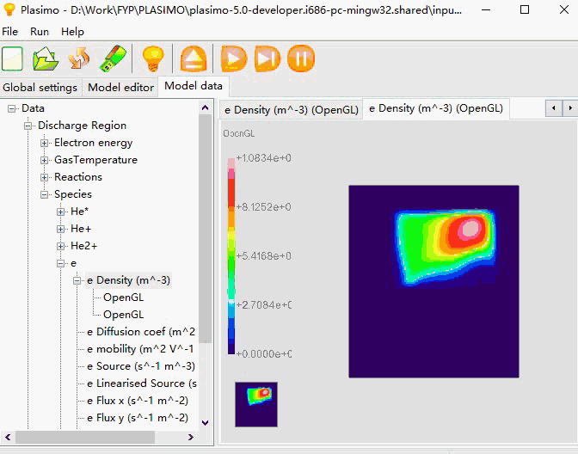
Background theory
Transient and steady-state simulations of plasma sources
POWERFUL!
plasimo-5.0-developer
Notes:
Edit as you see fit

Slide 4
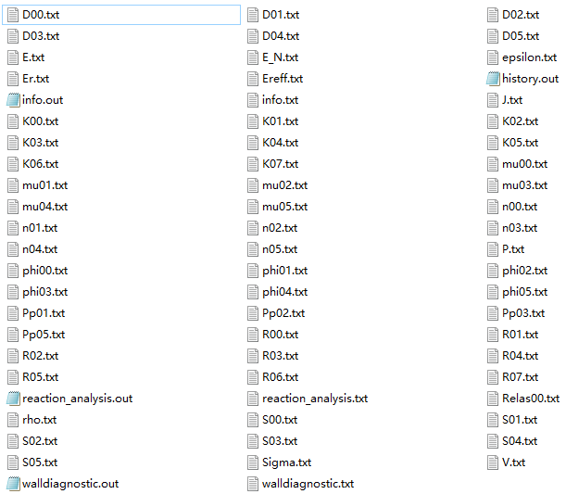
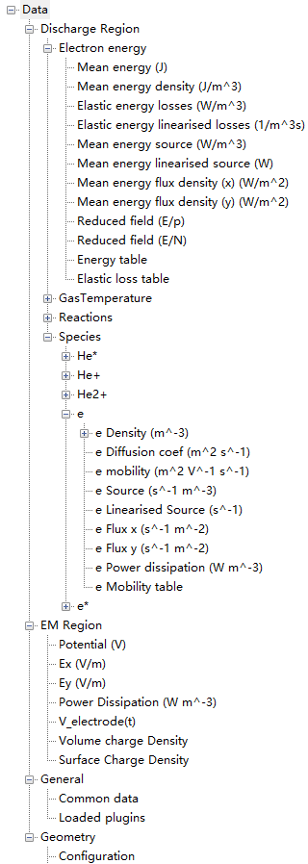
Background theory
68 text files as output data

Slide 5
Background theory
Transient and steady-state simulations of plasma sources
POWERFUL!
IRREVERSIBLE!
TIME-CONSUMING!
plasimo-5.0-developer
Notes:
Edit as you see fit

Slide 6
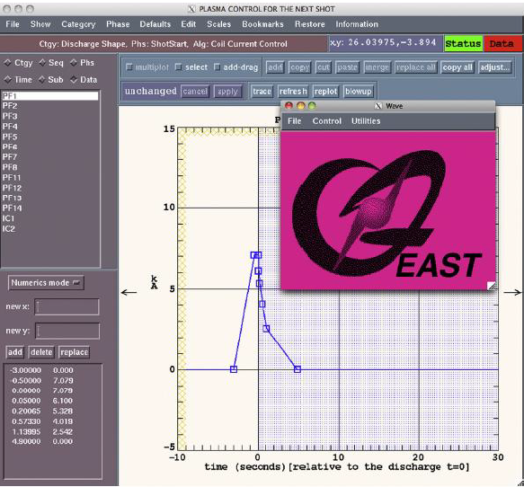
Literature review
The web-based user interface for EAST plasma control system
Drawing the user interface
Processing user requests
Test and Analysis
REF:R.R. Zhang, B.J. Xiao, Q.P. Yuan, F. Yang, Y. Zhang, R.D. Johnson, B.G. Penaflor, " The web-based user interface for EAST plasma control system", J. Appl. Phys. February 2014, DOI: 10.1016/j.fusengdes.2014.02.070

Slide 7
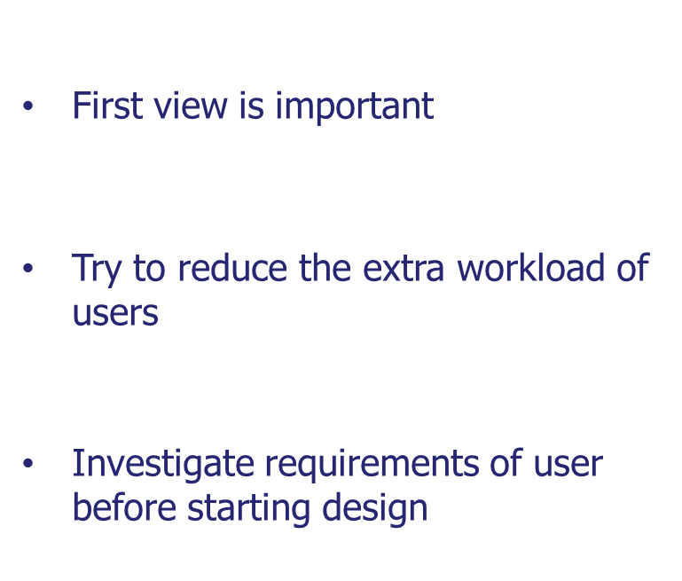
Literature review
The web-based user interface for EAST plasma control system
REF:R.R. Zhang, B.J. Xiao, Q.P. Yuan, F. Yang, Y. Zhang, R.D. Johnson, B.G. Penaflor, " The web-based user interface for EAST plasma control system", J. Appl. Phys. February 2014, DOI: 10.1016/j.fusengdes.2014.02.070

Slide 8
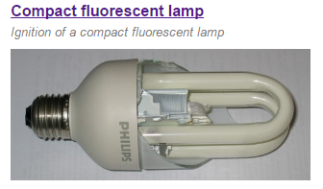
Market survey
Micro Discharge 2D(md2d) model
High efficiency
Long life time
Investigate reason of breakdown
Application of md2d model
REF:https://plasimo.phys.tue.nl/applications/index.html

Slide 9
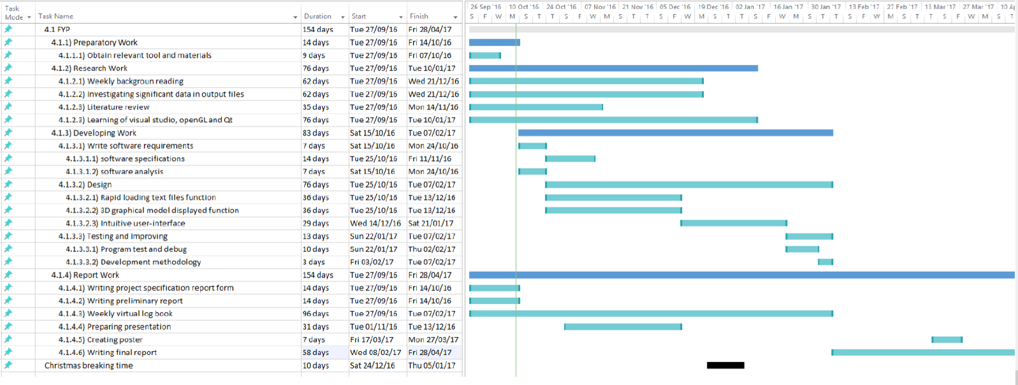
Project planning

Slide 10
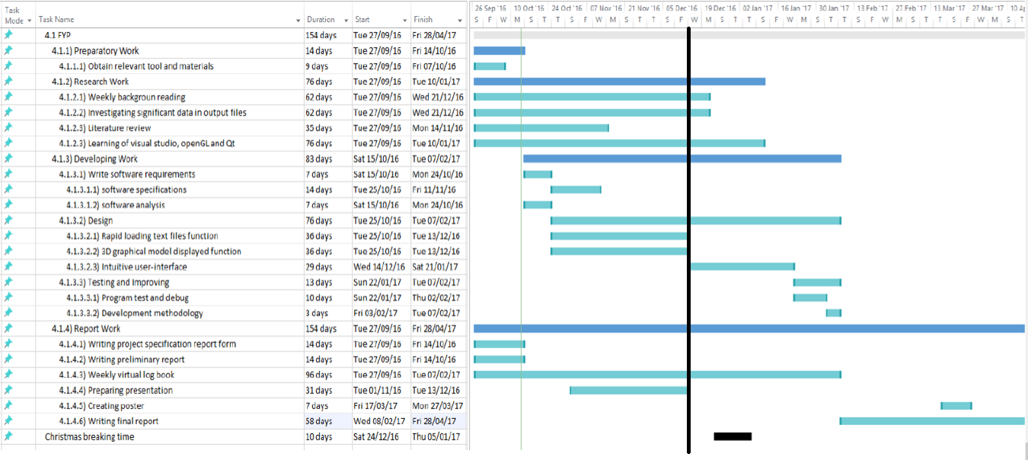
Project planning
Milestones
Week 3
preparatory work
project specification
DSE assessment
Preliminary report
Week 11
UI design
Programming study
Preliminary interface
13/12/2016

Slide 11
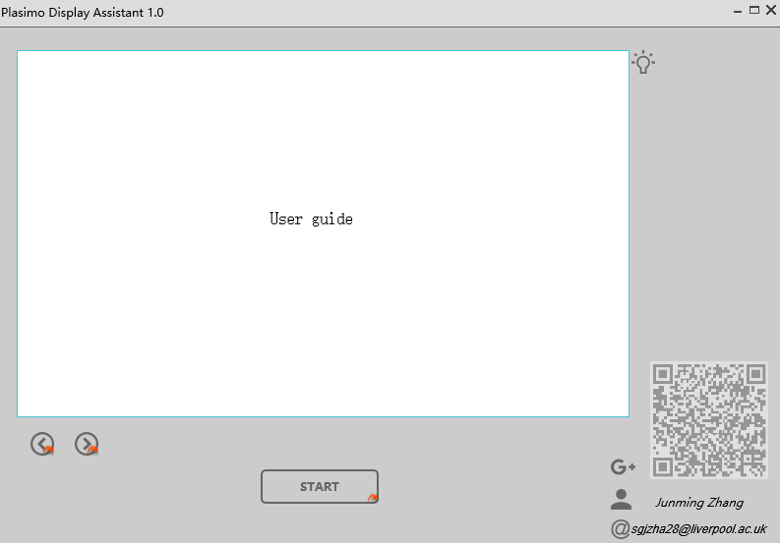
Progress made so far
Open specified guide
Scan to open blog
Read basic operation
Choose output folder

Slide 12
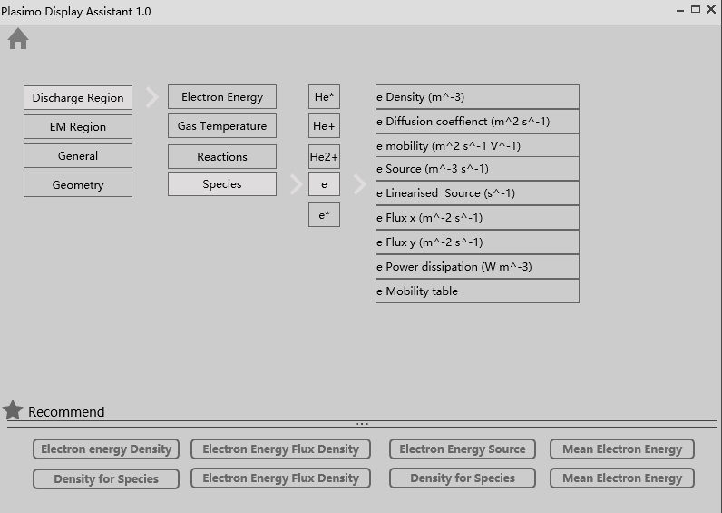
Progress made so far
Main Menu
Quick Menu

Slide 13
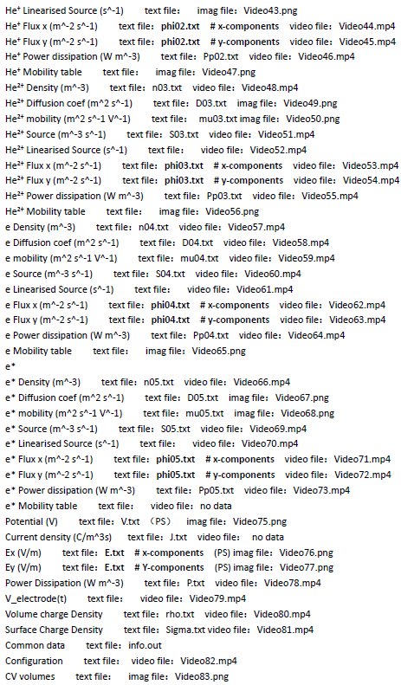
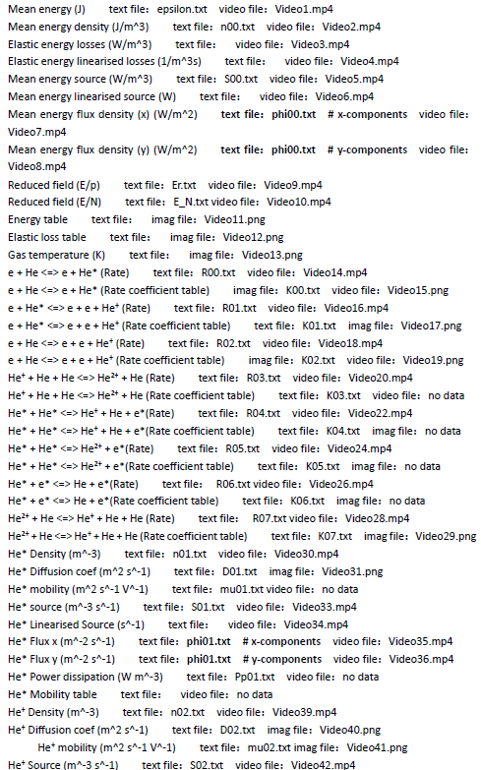
Progress made so far
68 text files
85 video or image files
Match them to the menu

Slide 14
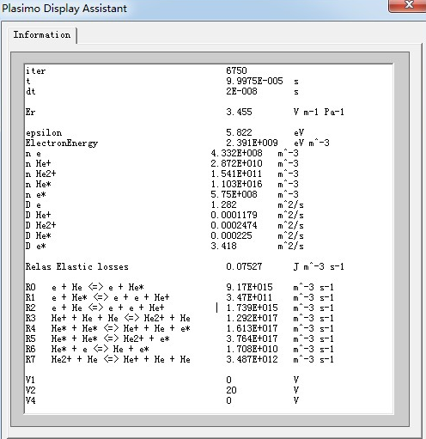
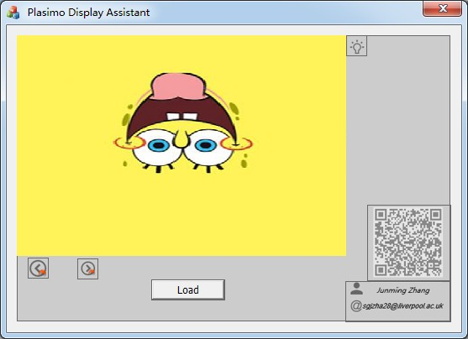
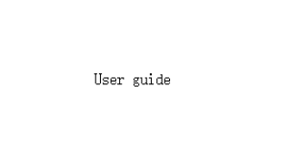
Progress made so far

Slide 15
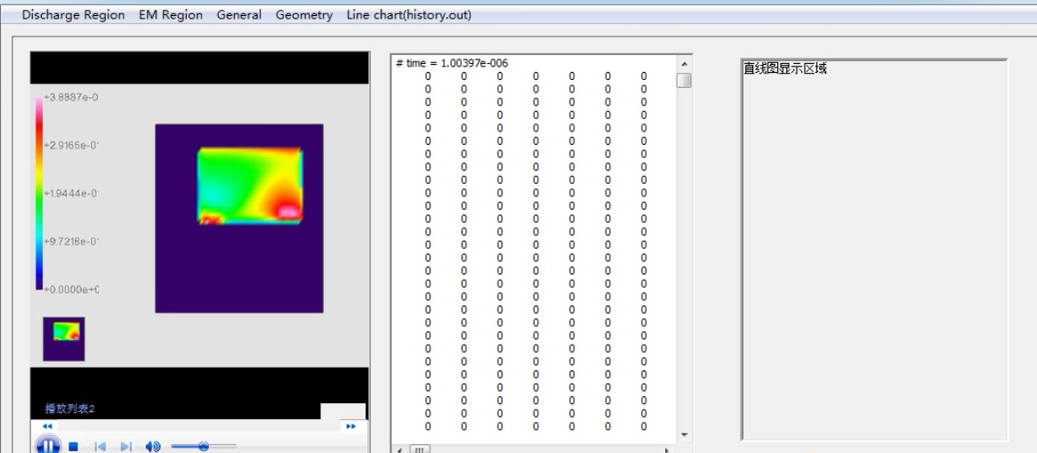
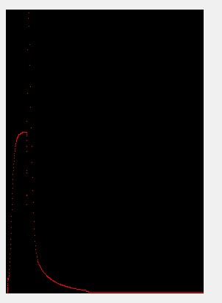
Progress made so far
Still need to change the layout

Slide 16
Thanks for your listening
Any Questions?

